Slide 1
Design Pattern
By Ramtin Shakeri

Slide 2
Design Pattern
In software engineering, a software design pattern is a general, reusable solution to a commonly occurring problem within a given context in software design. It is not a finished design that can be transformed directly into source or machine code. It is a description or template for how to solve a problem that can be used in many different situations. Design patterns are formalized best practice that the programmer can use to solve common problems when designing an application or system.

Slide 3
Design Pattern
Creational Patterns
Structural Patterns
Behavioral Patterns

Slide 4
Creational Patterns
In software engineering, creational design patterns are design patterns that deal with object creation mechanisms, trying to create objects in a manner suitable to the situation. The basic form of object creation could result in design problems or added complexity to the design. Creational design patterns solve this problem by somehow controlling this object creation.

Slide 5
Creational Patterns
Singleton
Factory Method
Abstract Factory

Slide 6
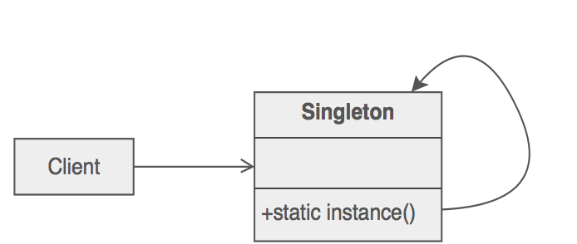
Singleton Pattern

Slide 7
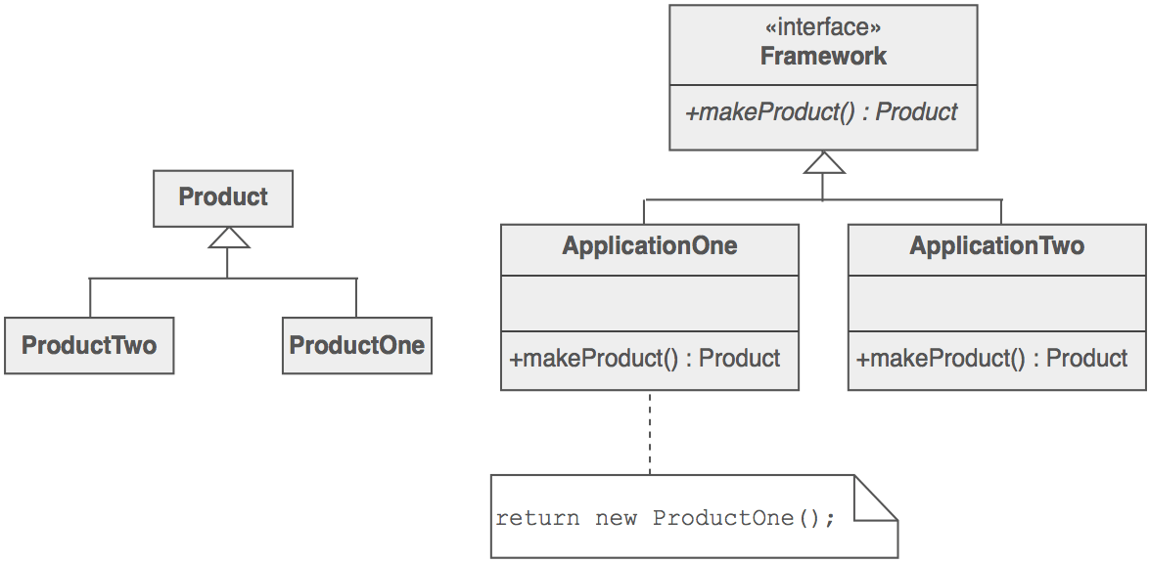
Factory Method Pattern

Slide 8
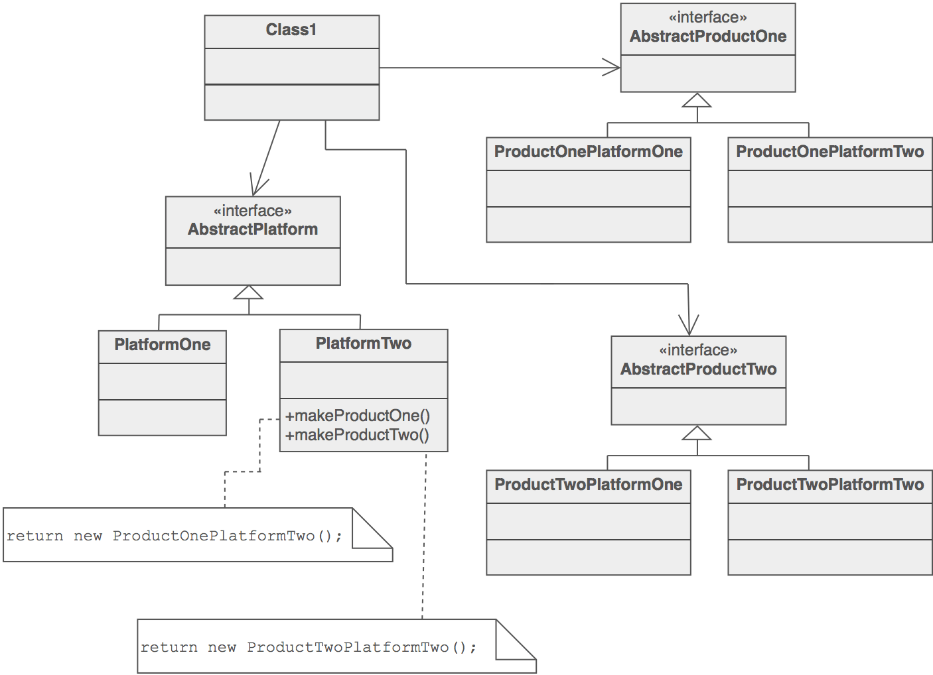
Abstract Factory Pattern

Slide 9
Structural Patterns
In Software Engineering, Structural Design Patterns are Design Patterns that ease the design by identifying a simple way to realize relationships between entities.

Slide 10
Structural Patterns
Adapter

Slide 11
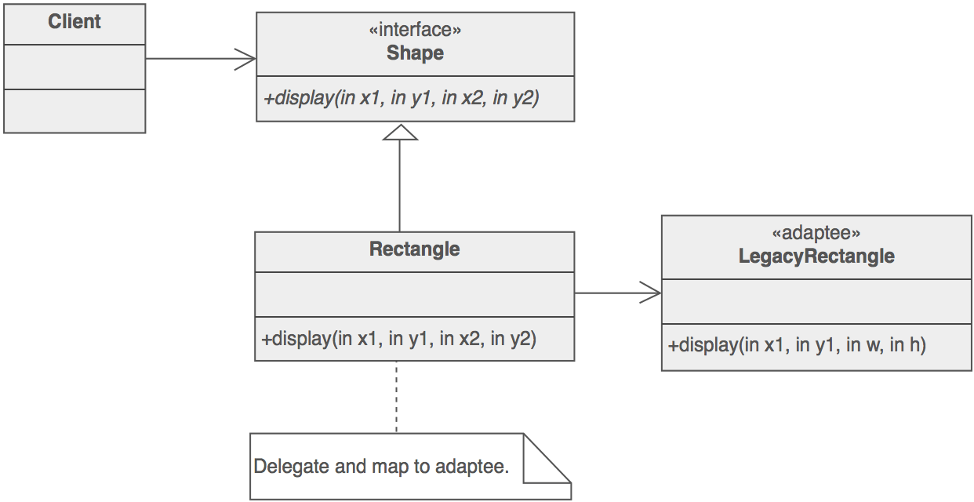
Adapter Pattern

Slide 12
Behavioral Patterns
In software engineering, behavioral design patterns are design patterns that identify common communication patterns between objects and realize these patterns. By doing so, these patterns increase flexibility in carrying out this communication.

Slide 13
Behavioral Patterns
Strategy
Observer
Command

Slide 14
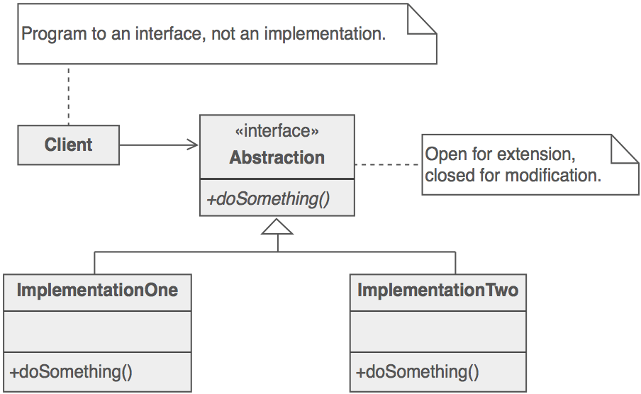
Strategy Pattern

Slide 15
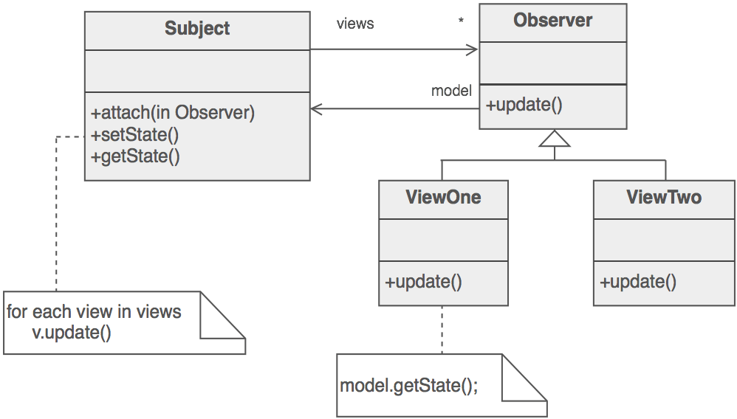
Observer Pattern

Slide 16
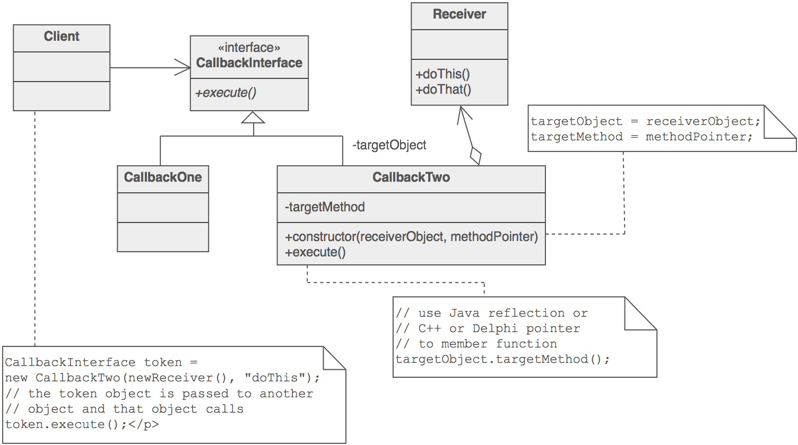
Command Pattern

